Slide 1
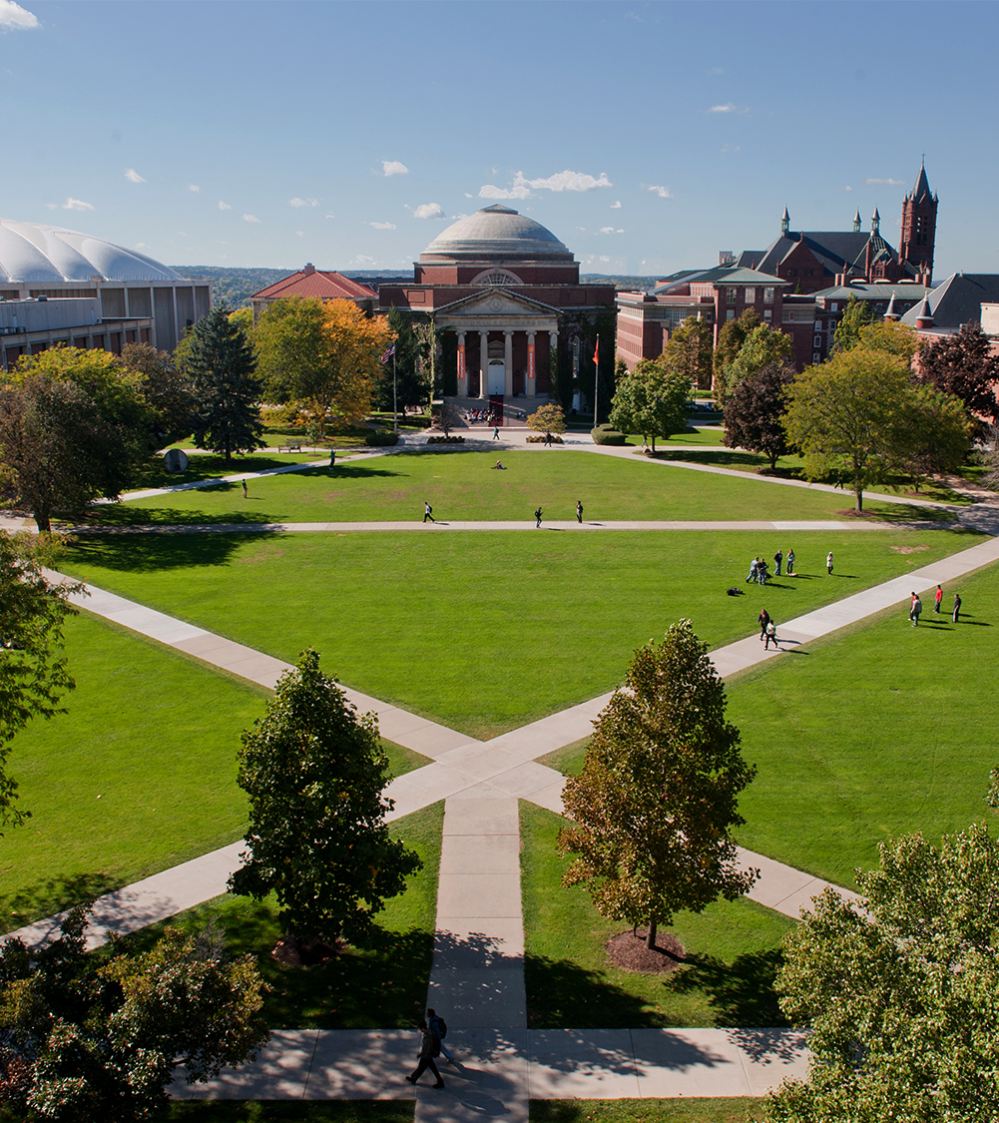
Master of Science Applied Data Science
School of Information Studies
Baskar Dakshinamoorthy
SUID: 956658856
July 08,2019

Slide 2
Applied Data Science Program
Introduction
The Applied Data Science program at Syracuse University’s School of Information Studies provides students the opportunity to collect, manage, analyze, and develop insights using data from a multitude of domains using various tools and techniques.
Reports and presentations were created in courses which exemplify the skills developed in the program including, but not limited to:
IST 736: Text Mining
IST 707: Data Analytics
IST 718: Big Data Analytics
IST 719: Information Visualization

Slide 3
MSDS-Learning Objectives
The Applied Data Science Program has seven Learning Objectives:
Describe a broad overview of the major practice areas in data science.
Collect and organize data.
Identify patterns in data via visualization, statistical analysis, and data mining.
Develop alternative strategies based on the data.
Develop a plan of action to implement the business decisions derived from the analyze
Demonstrate communication skills regarding data and its analysis for relevant professionals in their organization.
Synthesize the ethical dimensions of data science practice.

Slide 4
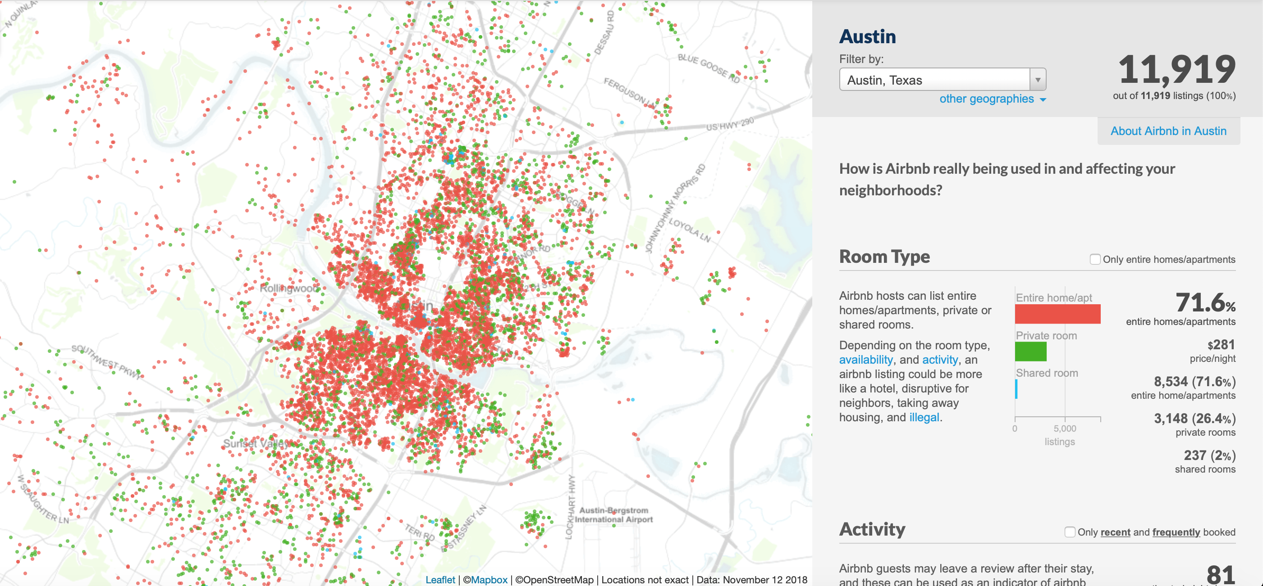
IST-736:Text Mining
AirBnB Price Prediction

Slide 5
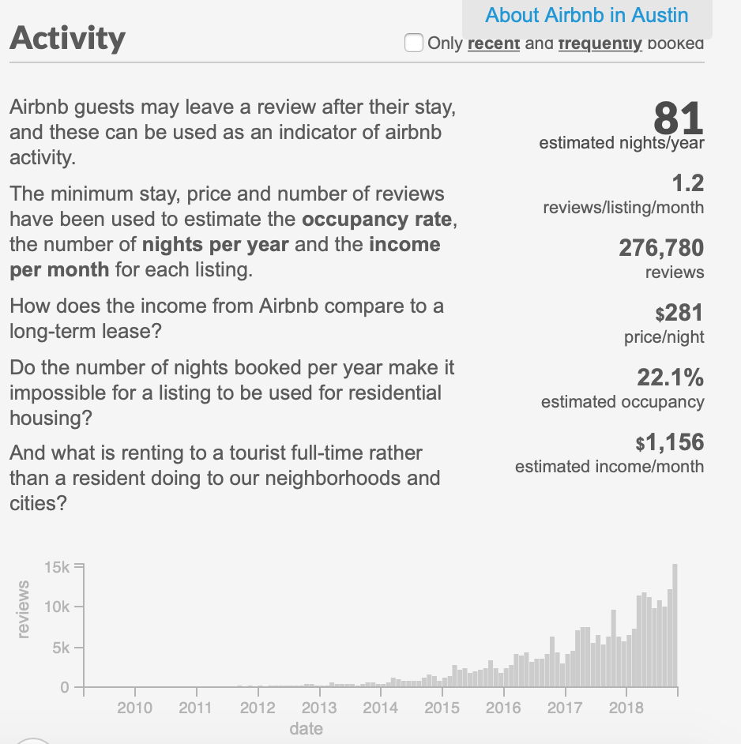
Text Mining
Goals and Business Questions
What are the positive and negative reviews (based on review text).
What are the main factors that influence Airbnb renting price.
Correlation between reviews, scores and locations vs price.

Slide 6
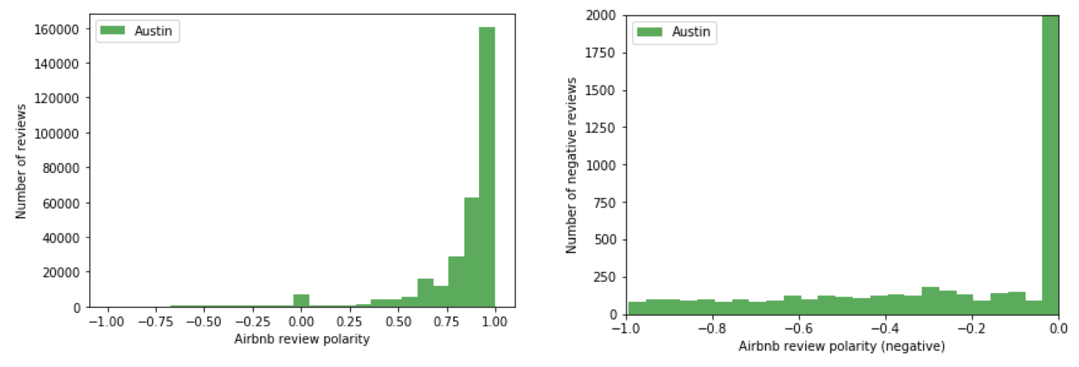
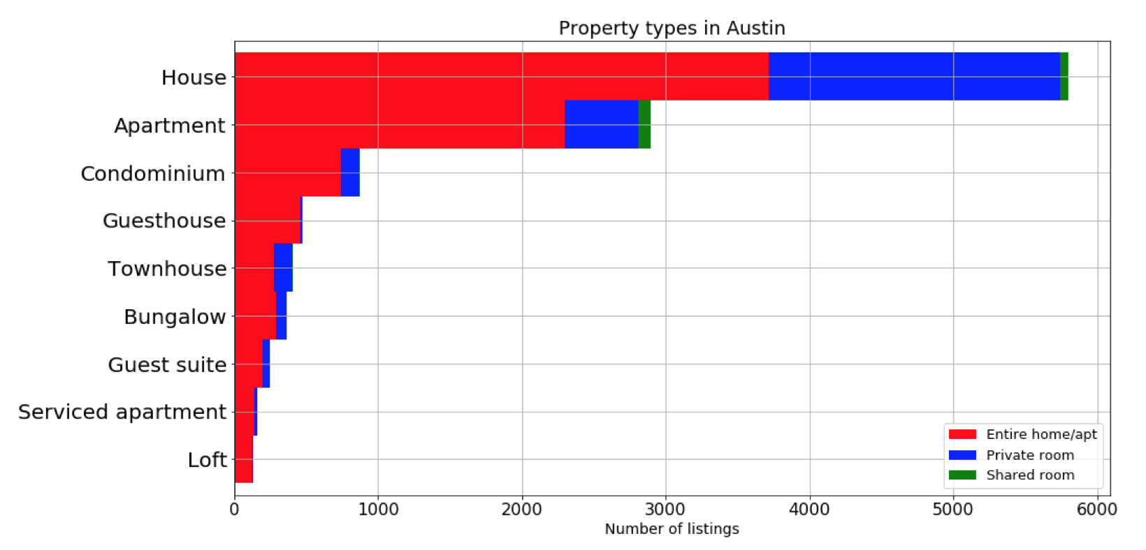
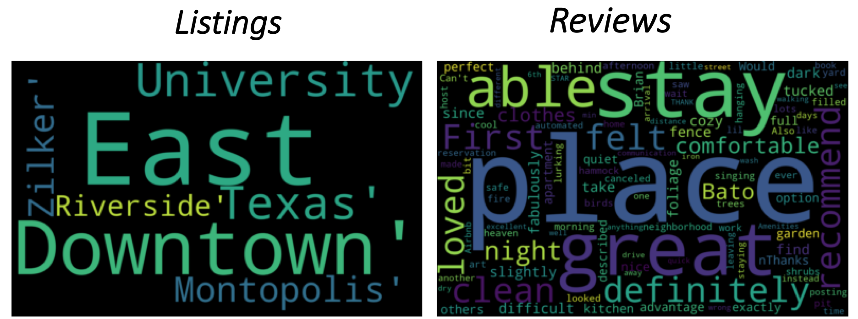
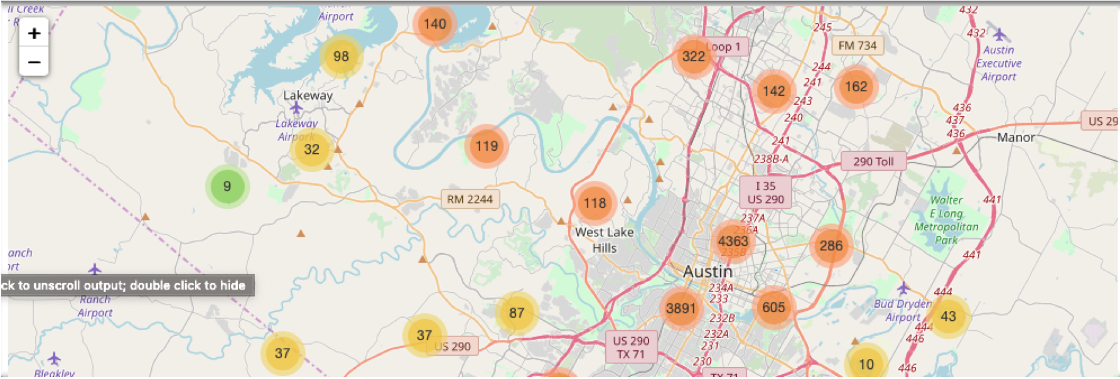
Text Mining

Slide 7
Text Mining
Learning Outcomes
This project required understanding a business problem, gathering the required data, performing analysis, implementing solutions, and measuring any success of the outcomes.
Used Vader sentiment Analysis framework to calculate review polarity scores .
Three Classifier models like Multinomial Naïve Bayes (MNB), Bernoulli Naïve Bayes (BNB) and linear Support Vector Classifier (SVC) models were used for predictive modelling

Slide 8
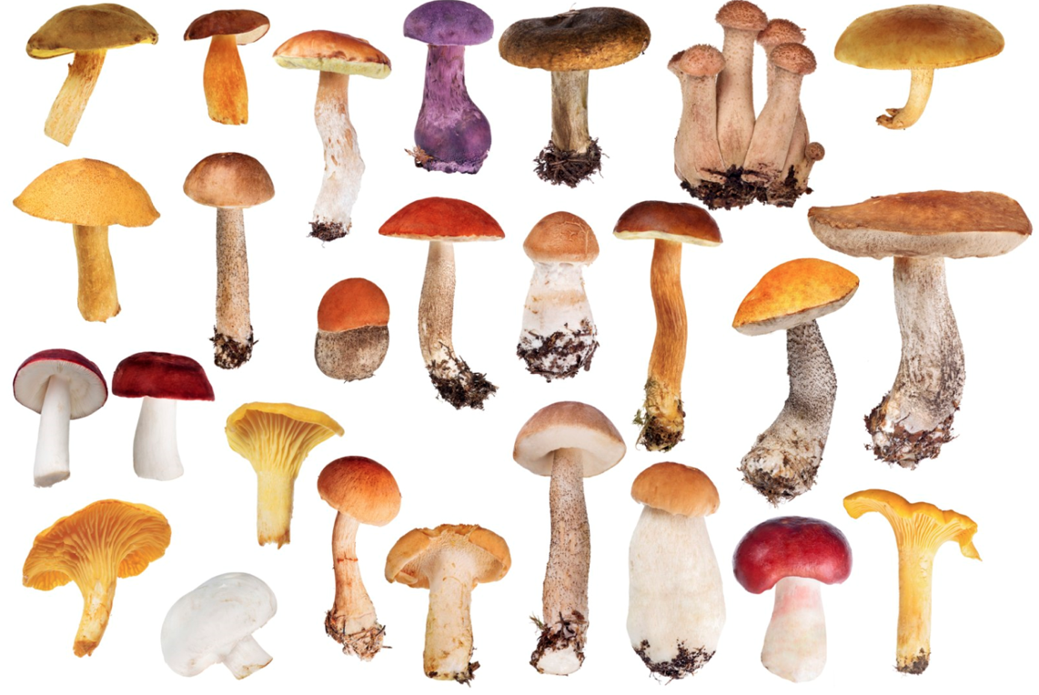
IST 707
Data Analytics:
Mushroom Classification
Poisonous or Edible?

Slide 9
IST 707: Data Analytics
Introduction
Various data mining techniques were used in this project which perform with varying precision and efficiency for applications in regression, classification, and clustering to identify if a Mushroom is poisonous or edible.
In this application, Naive Bayes, Random Forest,KNN and Decision Tree Classifiers are compared with respect to computation time and accuracy to predict the edibility of mushrooms.
R Studio is leveraged to conduct analysis using data from Kaggle.

Slide 10
IST 707: Data Analytics
Methodology
This project required the cleaning and preprocessing of data.
This involved the transformation of 22 categorical features into 96 boolean vectors.
One-Hot Encoding also facilitated the identification of patterns within the data.
Recent findings suggest Naive Bayes is the preferred classification algorithm over decision trees.
However, observations made in this application revealed nearly three percent greater accuracy across five-fold cross-validation using decision trees in
one-tenth the time in comparison to Naive Bayes.
Decision trees predicted with an average 99.14% accuracy in 1.7 seconds of training.
Naive Bayes predicted with an average 96.51% accuracy in 13.9 seconds of training.

Slide 11
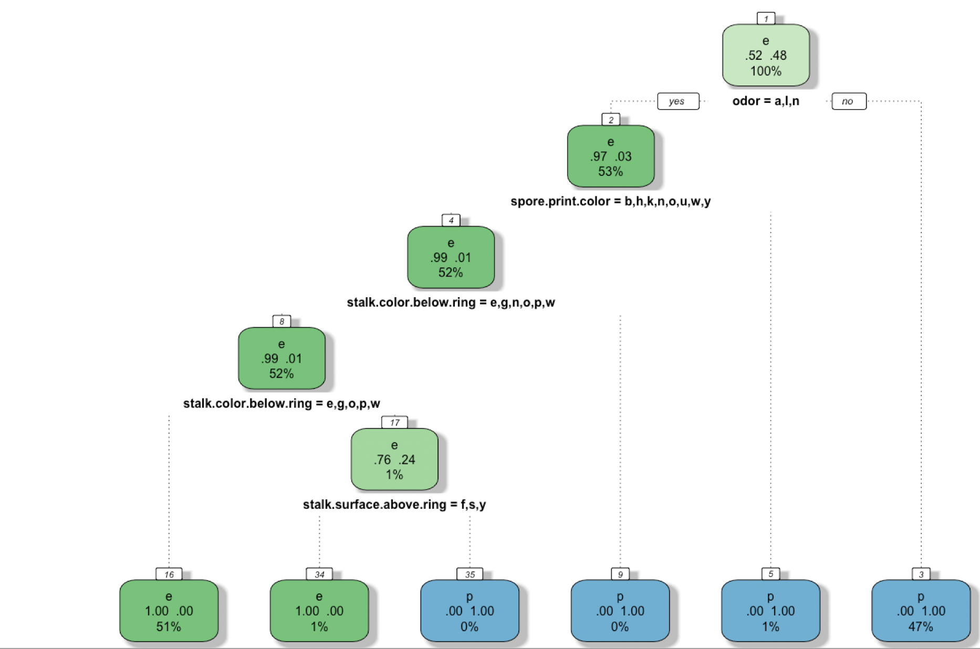
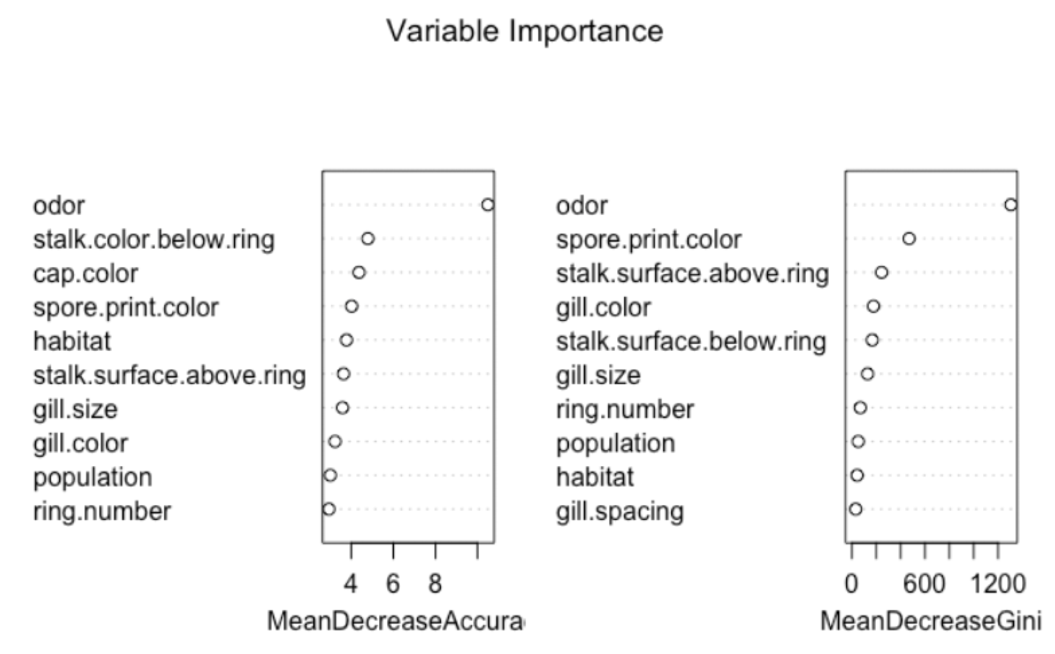

IST 707: Data Analytics

Slide 12
IST 707: Data Analytics
Learning Outcomes
Document, analyze, and translate data mining needs into technical designs and solutions.
Apply data mining concepts like association rule mining, random forest, and clustering analysis and Machine Learning Models like Support Vector Machines helped in predictive analysis.
Employ data storytelling and dive into the data, find useful patterns, and articulate what patterns have been found, how they are found, and why they are valuable and trustworthy.
R was used to perform the final predictive analysis that involved extensive data cleaning and feature engineering was used to combine the data from the different datasets into one final table that was used to create the models.

Slide 13
IST-718
BigData Analytics:
Can Pre-Movie Hype Predict Box Office Results

Slide 14
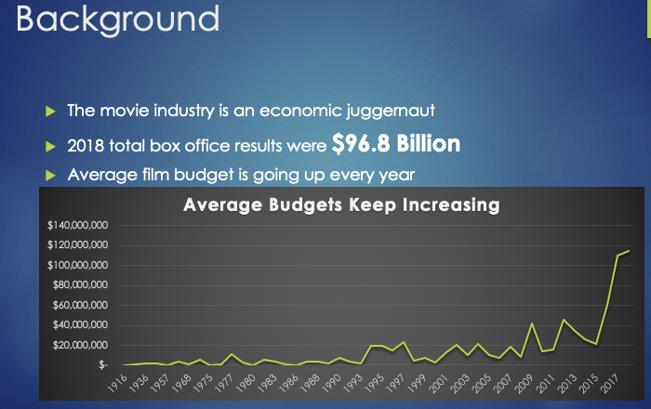
IST 718: BigData Analytics
Business Question
Can we predict the Box Office Results of the next franchise film based on previous results and the sentiment of tweets and rotten tomato reviews?

Slide 15
IST 718: BigData Analytics
Methodology
This project required sourcing data from Wikepedia,Twitter and Rotten Tomatoes
This involved web scraping using Beautiful Soup, Cleaning of twitter data using Tweepy
Multiple Dataframes were created and merged after extensive cleaning and preprocessing.
For each tweet and Rotten Tomato results, a sentiment score was calculated using VADER to figure out whether the
Polarity scores determine if a movie is recommended or not
Ran Ordinary Least square Linear regression model with universe, budget, Polarity and months to predict the box office results of next franchise film.
Did a Multi-Class Text classification with SciKit-Learn to build prediction model predicting movie categories based on the movie reviews

Slide 16
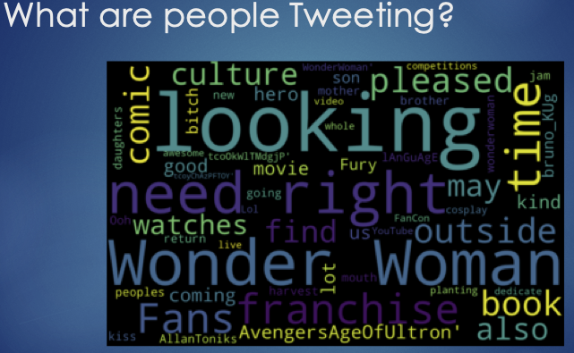
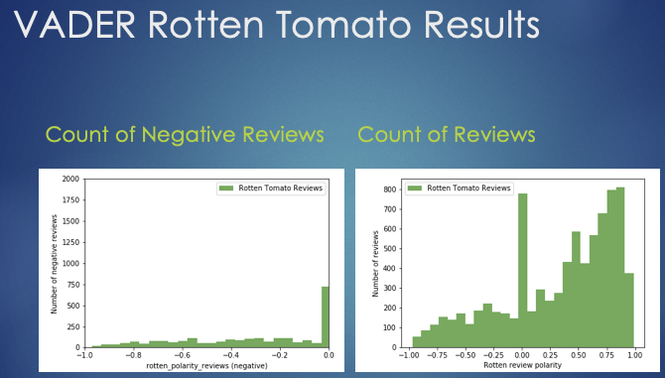
IST 718: BigData Analytics
Sentiment and Twitter Analysis

Slide 17
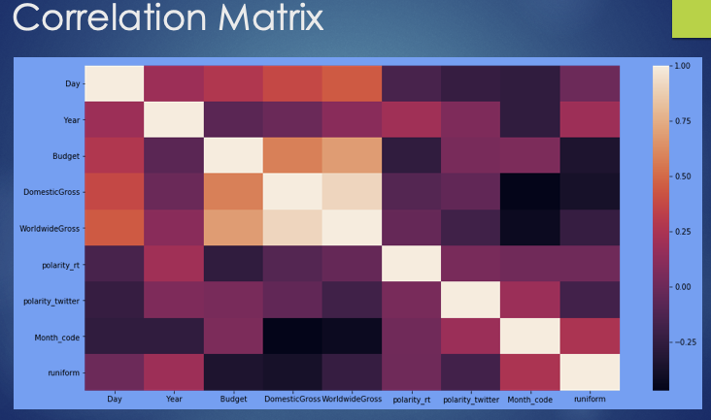
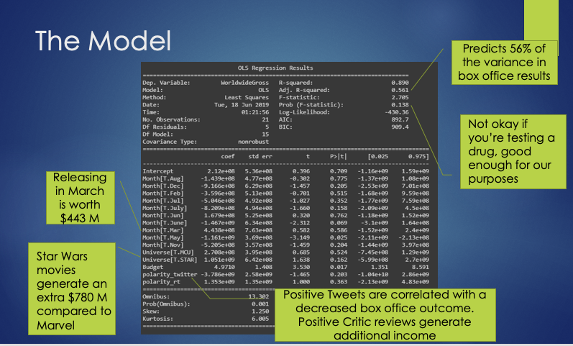
IST 707: Data Analytics
Correlation Matrix and Model

Slide 18
IST 718: BigData Analytics
Learning Outcomes
This project was an opportunity to take all knowledge gained from the core curriculum and demonstrate the ability to combine data sets to produce meaningful analysis.
Scrub data by applying scripting methods, to include debugging, for data manipulation in Python, R or other languages.
Explore data by analyzing using qualitative techniques including descriptive statistics, summarization, and visualizations.
Modeling relationships between data matched to the information and needs of clients and users Interpreting the data, model, analysis, and findings and Communicating in a meaningful way.
This project also required to build a data frame, fit a regression model and find relevant predictors, and think creatively about how to organize and re- organize the data.

Slide 19
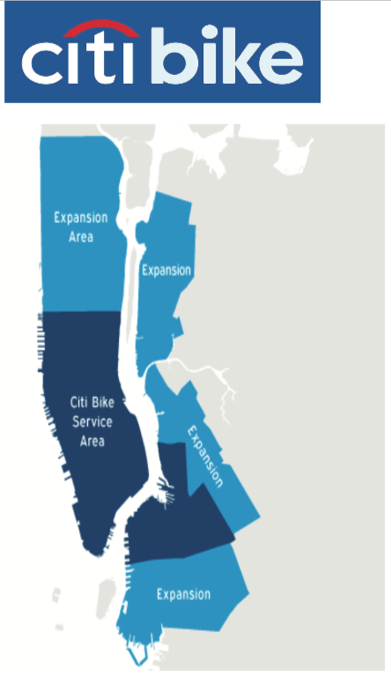
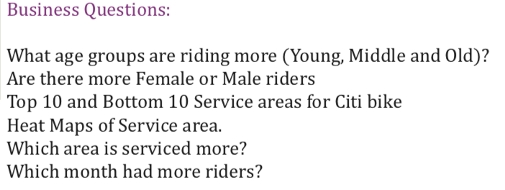
IST-719:Information Visualization
NewYork Citibike Program

Slide 20
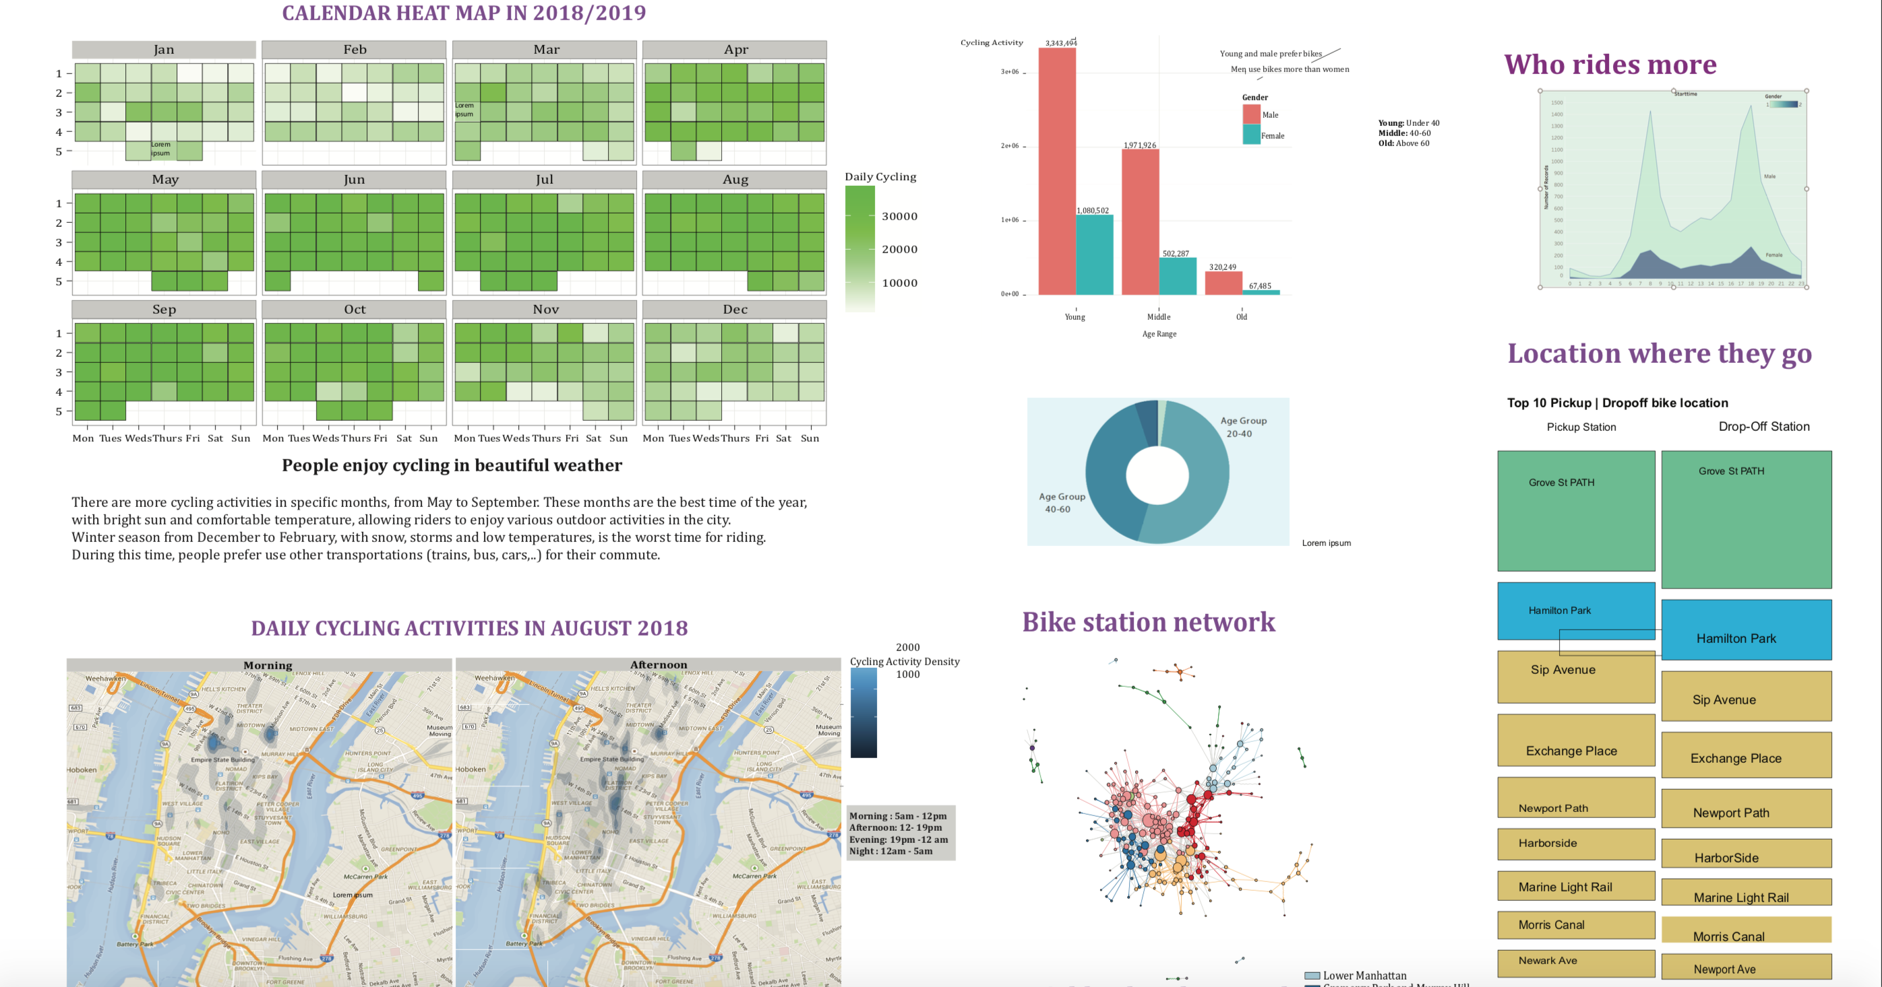
IST-719:Information Visualization
Various Viz based on monthly data

Slide 21
IST-719:Information Visualization
Learning Outcomes
This project was an opportunity to showcase skills on data cleaning and preparation on a wide range of data sets
Identify stories in data sets through exploration
Create rich visual artefacts that communicate data stories like where Citibike can expand its network based on Bike Network safety ratings
Use Adobe Illustrator to combine R data visualizations, design elements and
context cues into a single artifact
Critically assess visualizations like on which month the riders are more and why.

Slide 22
Conclusion
Syracuse University’s School of Information Studies provides students the opportunity to synthesize the collection, management, and analysis of data, as well as the delivery of actionable insights using various data science techniques.
Skills learned in the program have developed a multifaceted approach to solving structured and unstructured data problems with increasing complexity.
It has cultivated strategies which improve organizational efficiency.
The program has fostered a practice of transparency, reproducibility, and ethical data management which promotes integrity within an organization’s analytics team.
Using the skills learned in the Applied Data Science program, data scientists are equipped with the ability to tackle a wide range of problems and the resources to explain observations to a variety of stakeholders and business professionals.

Slide 23
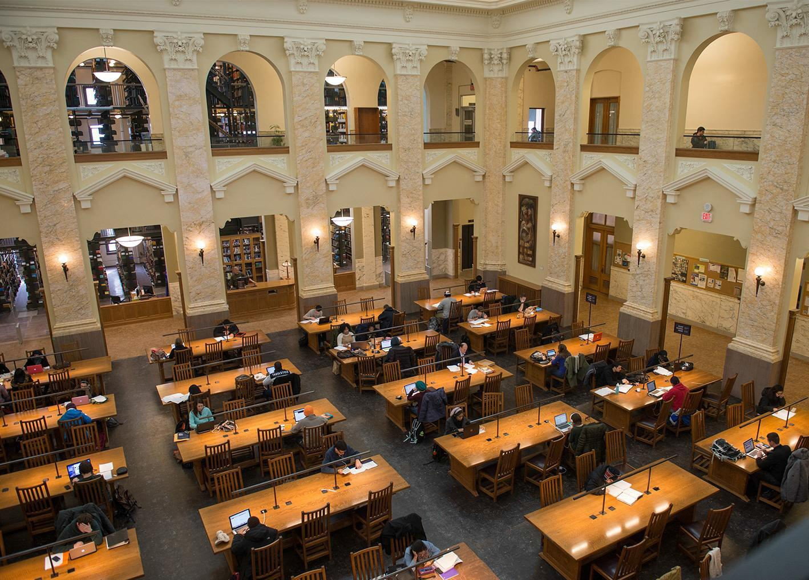
Thank You!
Template Retrieved from:
https://www.syracuse.edu/about/brand/visual-identity/powerpoint-templates/

